Slide 1
Social Emotional Learning Journal Prompts Thoughtful Journal Prompts to Inspire Meaningful Discussion
Unit 2: Conflict

Slide 2
“Peace is not the absence of conflict, but the ability to cope with conflict by peaceful means.”-Ronald Reagan
Do you agree or disagree with this statement? Is it possible to live a life without conflict? Why or why not?

Slide 3
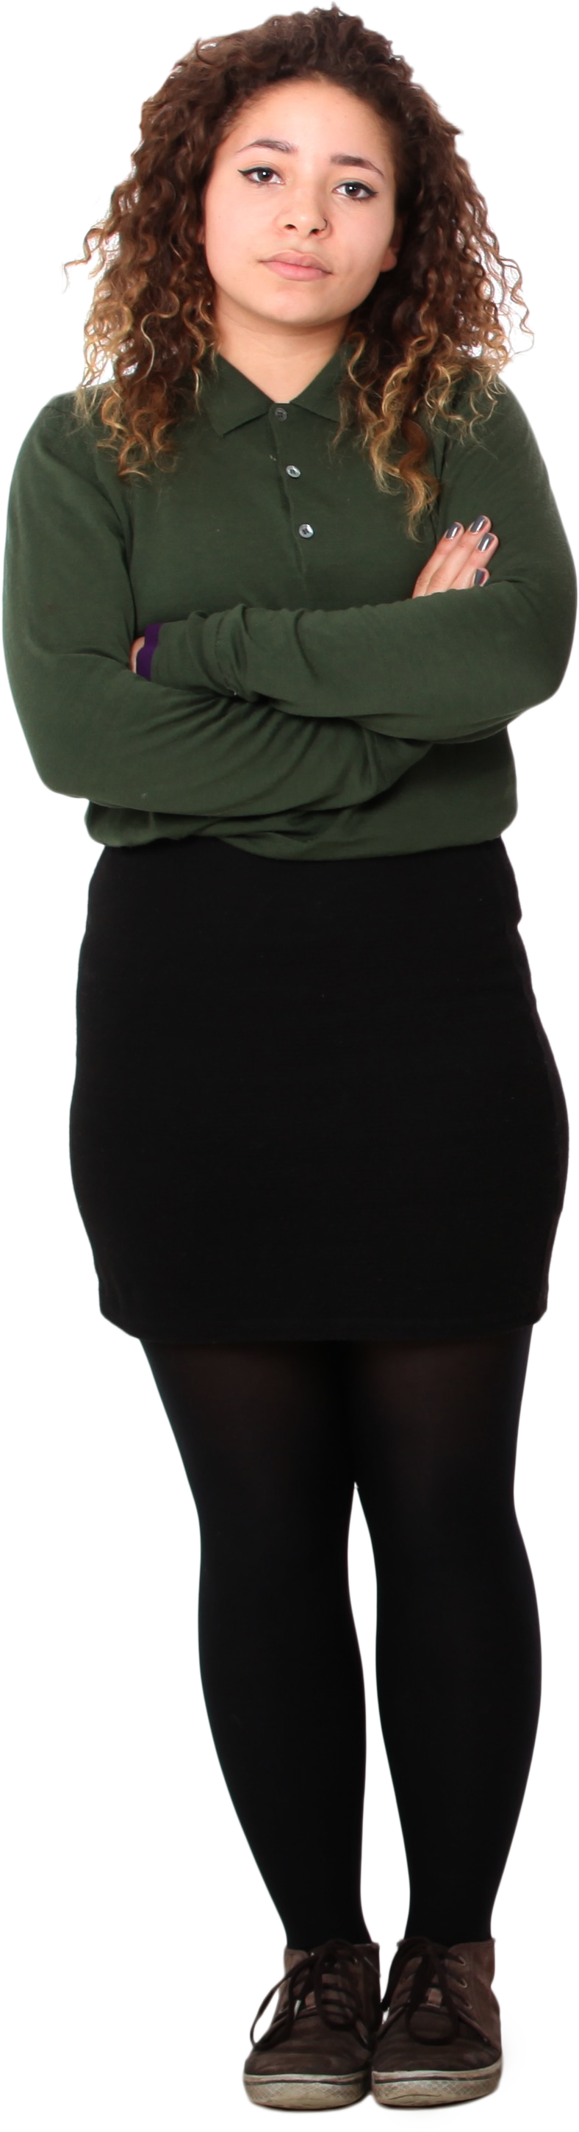
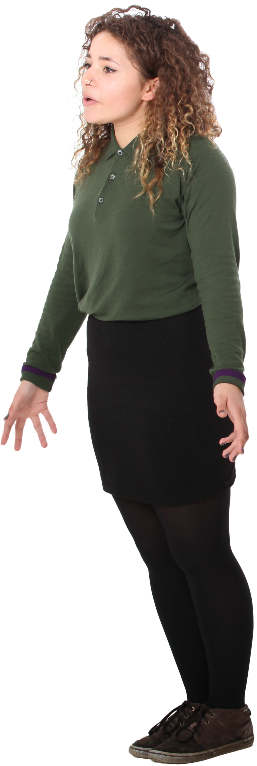
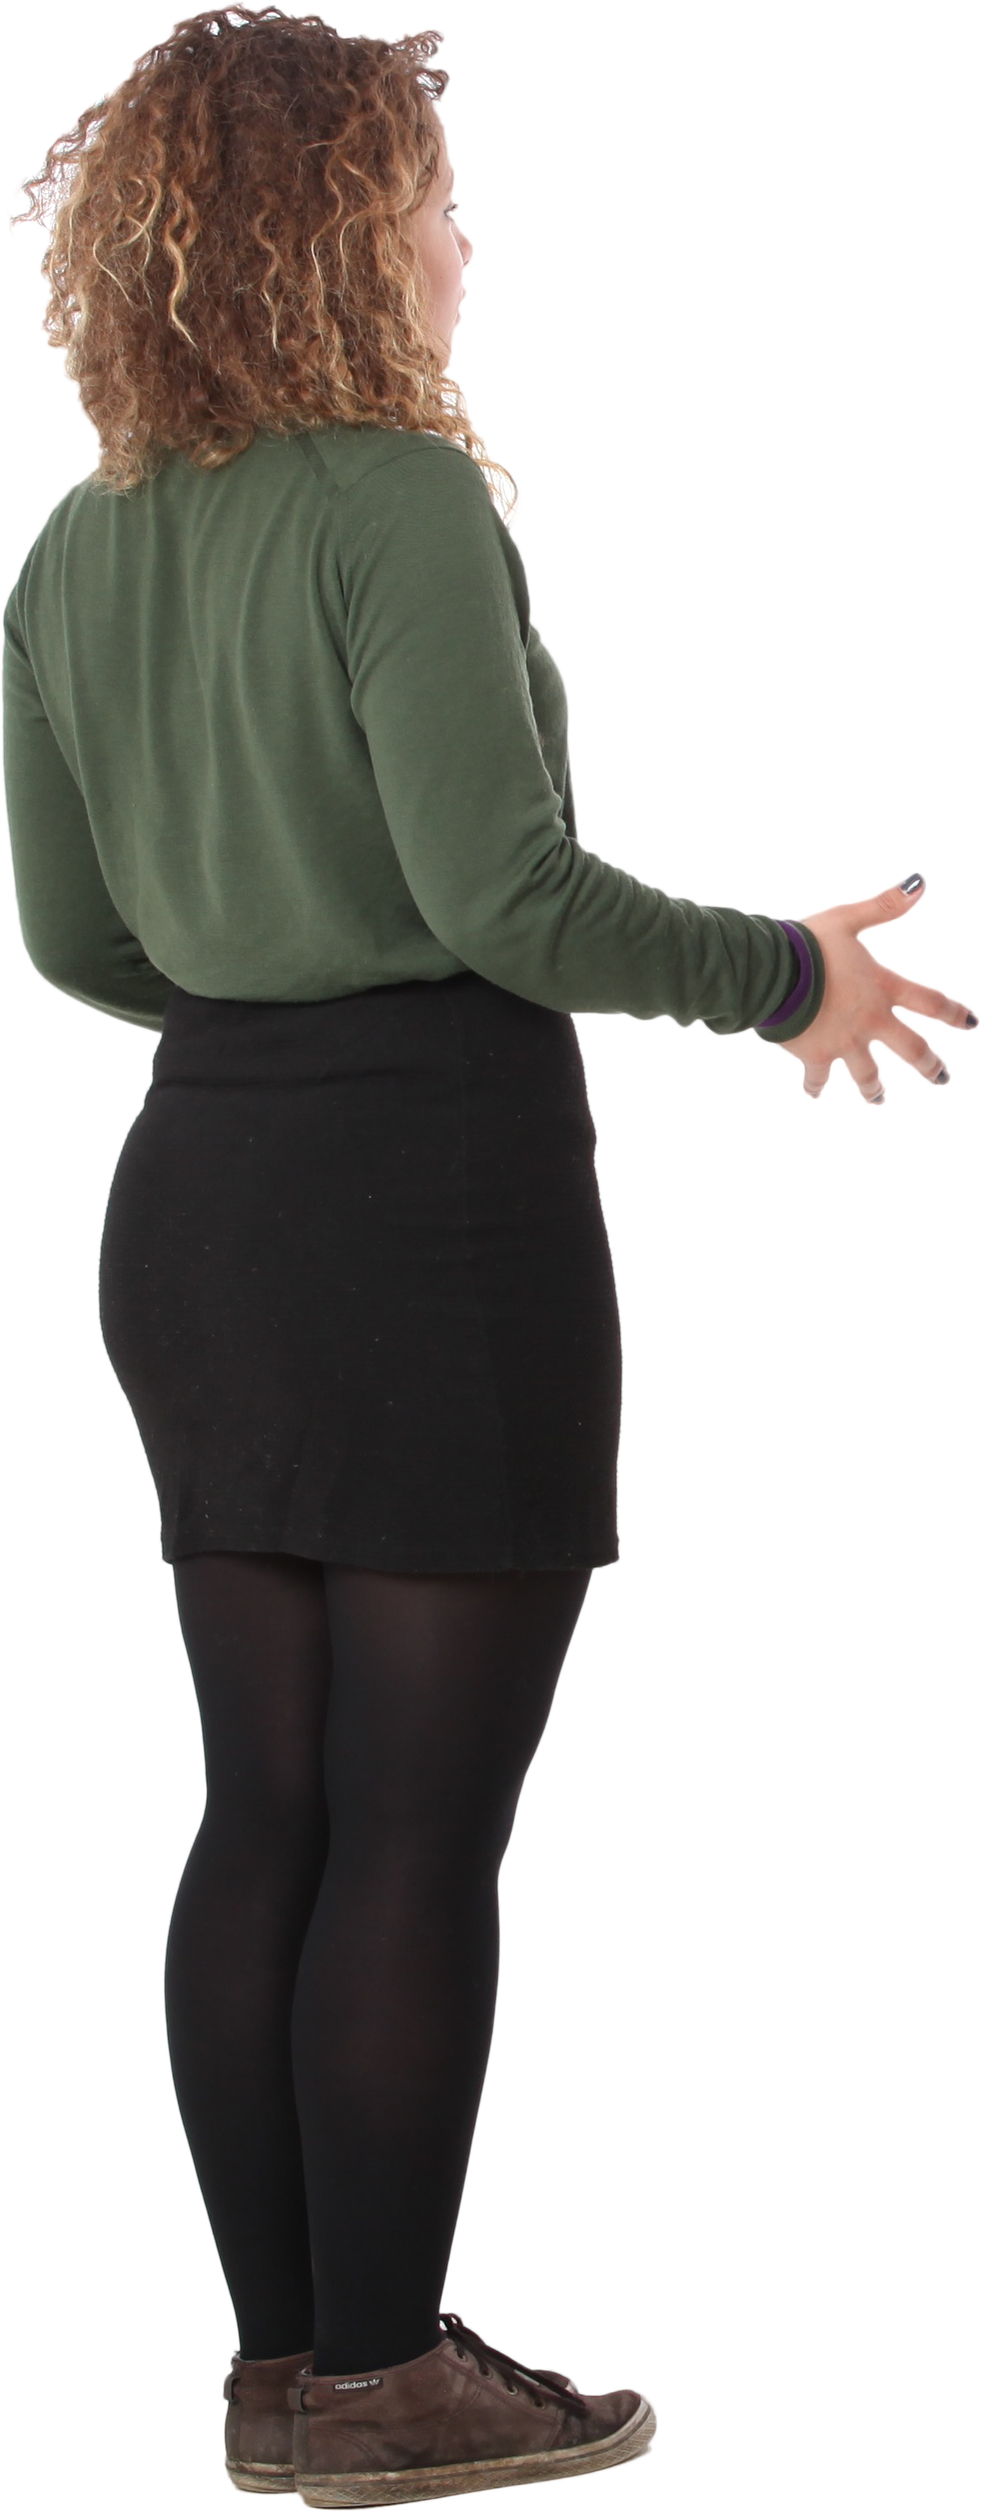
Describe a time when you faced conflict within yourself. What was the situation? What did you decide? What led you to this decision?

Slide 4
“I don’t like that man. I must get to know him better.”-Abraham Lincoln
Have you ever engaged in conflict only to find out later that you didn’t have all the facts?
When have you disliked someone before getting to know them?

Slide 5
“I felt like we had stories about family loyalty; I didn’t feel like we had stories about what to do when you felt that loyalty to your family was in conflict with loyalty to yourself” –Tara Westover
Have you ever felt that what you value conflicts with what your family values? How have you dealt with this?

Slide 6
“Courage is what it takes to stand up and speak. Courage is also what it takes to sit down and listen.” Winston Churchill
When is it best to stand up and speak?
When is it best to sit down and listen?
What prevents you from speaking or listening during a conflict?

Slide 7
“I define connection as the energy that exists between people when they feel seen, heard, and valued” –Brene Brown
Think about a conflict you have had with someone you love. During the conflict, did you see, hear, and value the other person? Did the other person see, hear, and value you? Why or why not?

Slide 8
How we sometimes choose to see conflict: Me vs. you
How we could choose to see conflict: Me and you vs. the problem
What does this mean?
Is it possible to partner with someone with whom you have conflict to solve a problem?

Slide 9
“Conflict is inevitable, but combat is optional” Max Lucado
What is the difference between conflict and combat?
Have you ever had conflict without combat? What happened? What does it look like to have a conflict without combat?

Slide 10
Write about a time in which you were hurt by conflict.
Who was involved in the conflict?
Has the conflict been resolved?
What was the outcome?
What outcome would you have liked?

Slide 11
Conflict can often lead to regret. Think about something you said or did because of a conflict that you now regret.
Write a letter to the person you hurt. Discuss how you feel about your words or actions now.

Slide 12
Bonus: Additional Resources and Discussion Starters
Chauveron, Lisa & Thompkins, Amanda. (2012). Urban Conflict Resolution: An Evidence-Based Approach. Journal of Youth Development. 7. 40-48. 10.5195/JYD.2012.139.
Books/Poems highlighting conflict:
Braving the Wilderness by Brene Brown Educated by Tara Westover Romeo and Juliet by Shakespeare The Glass Castle Jeanette Wells The Calculating Stars by Mary Robinette Kowal
Additional Discussion Starters:
Do you tend to avoid conflict? Why?
Who is someone you know who handles conflict well?
Have your emotions ever led to unhealthy conflict? What happened?
Would the world be a better place if there were no conflict or disagreements? Why or why not?
When have you noticed conflict with a positive outcome?
Can relationships heal after conflict? Why or why not?
How can you begin to engage in conflict in a healthy way?
Do you notice a pattern in the conflict you engage in? If so, what?
Discuss a time in which you were proud of how you responded to conflict.
How can you respect yourself and other people in conflict?

Slide 13


Thank you for purchasing this resource! I’d love to hear about your experience with these prompts. Please remember to leave feedback and let me know!
Thank you!
-April
https://www.teacherspayteachers.com/Store/Empower-Healthy-Students EmpowerHealthyStudents

